Slide 1
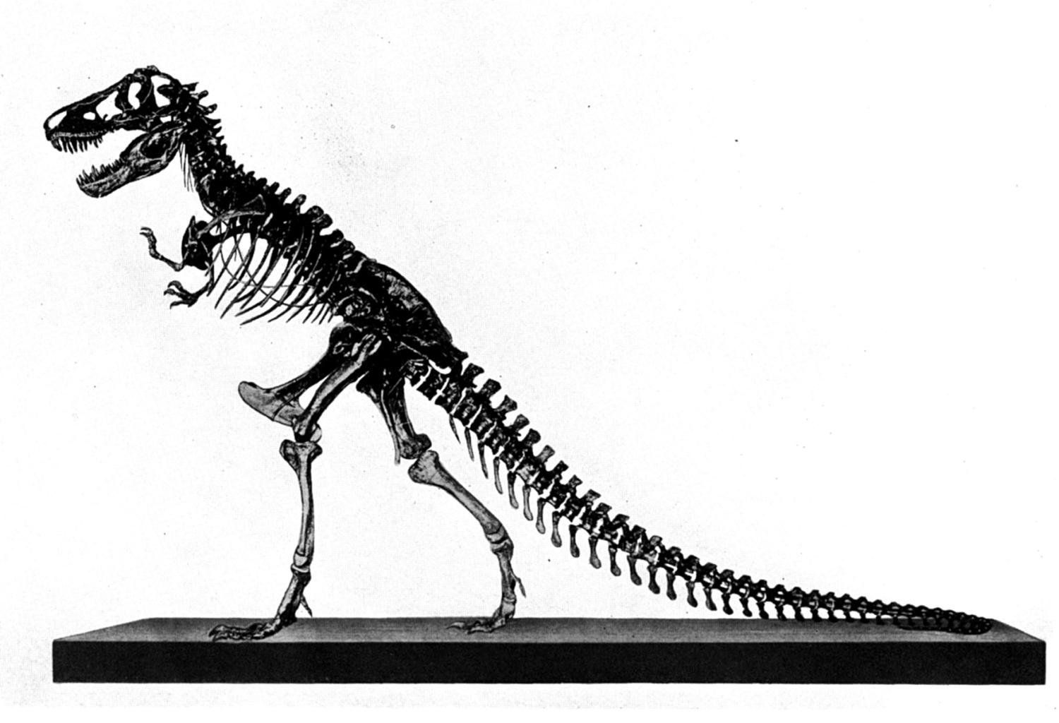
Behemoth &
Leviathan
Job 40:15-41:34
Part 1 | Introduction

Slide 2
Why Preach On This?
Because it is scriptural (2 Tim. 3:16)
Because atheists have deceived our society in promoting evolution and millions of years—a declaration of war against the scriptures and known truth
  “How shall the young secure their hearts?”
  KNOW BIBLE → TRUTH → LIFE/GODLINESS
  (2 Pet. 1:3)
  NO BIBLE → TRUTH→ RESTRAINT (Prov. 29:18)

Slide 3
Why Preach On Evidences?
“A survey at a university in Sydney, Australia, showed that approximately 80% of first year students at that institution ‘believe in a God who is there’. But ‘By their second year only 15% believe in God’. It is plain to see that this university has convinced these students that there in no God nor any need of God via the teaching of Secular Humanism, which is of course based upon evolution.”
(“The ‘Indoctrinator’,” Warwick Armstrong & Jonathan Sarfati, www.answersingenesis.org)

Slide 4
Why Preach On This?
Because dinosaurian creatures displayed the creative and awesome power of God to man
Because even some brethren publish misleading information about dinosaurs, Behemoth, Leviathan, etc.

Slide 5
DINO
DELUSION
“We have not found any reliable evidence that man and dinosaurs lived at the same time. …First of all the Bible does not talk about dinosaurs at all. Can you find dinosaurs mentioned in Genesis 1? No. The sixth day only talks about what we would call cattle and other mammal-type animals that the people of Moses' day lived with”
(“A Talk With Your Children About Dinosaurs,” Carol and Hill Roberts, 1993)
28 "The prophet who has a dream, let him tell a dream; And he who has My word, let him speak My word faithfully. What is the chaff to the wheat?" says the LORD.
29 "Is not My word like a fire?" says the LORD, "And like a hammer that breaks the rock in pieces? (Jer. 23:28, 29)
Notes:
Is Genesis 1 talking about the animals that Moses lived with or the animals which were originally created by God? These animals were created and were contemporaries with Adam and Eve.

Slide 6
Who Created Dinosaurs?
“For in six days the LORD made the heavens and the earth, the sea, and ALL that is in them, and rested the seventh day. Therefore the LORD blessed the Sabbath day and hallowed it” (Exodus 20:11)
“Happy is he who has the God of Jacob for his help, Whose hope is in the LORD his God, Who made heaven and earth, The sea, and ALL that is in them; Who keeps truth forever” (Ps. 146:5, 6)

Slide 7
Who Created Dinosaurs?
“and saying, ‘Men, why are you doing these things? We also are men with the same nature as you, and preach to you that you should turn from these useless things to the living God, who made the heaven, the earth, the sea, and all things that are in them, who in bygone generations allowed all nations to walk in their own ways” (Acts 14:15, 16)
Notes:
Three times in scripture, from the very beginning of the Bible, in the middle and even near the ending of it we are told important things about God and the “all” of creation. We learned from Exodus that God created not just the world, but everything in it in just six days. Since dinosaurs existed, they were therefore created.
We learn in Psalms that the happy man hopes in Jehovah who created all things. The fact of His being the Creator of all things is tied to His character which is of truth. He did not create dinosaurs to deceive us, but they are a manifestation of His own power.
We learn also in the Acts that we need to turn to the living God and the power of His life is seen by the fact that He created all things that are in the heaven, the earth, and the sea. When man disconnects the creator from the created, he conceals God’s power and begins to walk a course that abandons God and is on course to idolatry.
God does not allow us to walk in our own ways. We must acknowledge Him and strive to walk with Him. Since dinosaurs were created by God, it only seems reasonable that God’s word would talk about them. In fact, I suggest to you that the Bible speaks more of this kind of creature than perhaps any other kind.

Slide 8
Worthy of Worship!
Revelation 4:10, 11, “the twenty-four elders fall down before Him who sits on the throne and worship Him who lives forever and ever, and cast their crowns before the throne, saying: ‘You are worthy, O Lord, To receive glory and honor and power; For You created ALL things, And by Your will they exist and were created.’”
Notes:
A most fundamental reason why God is worthy of worship is because He is the creator of all things!

Slide 9
Deceiving the Young!
“First of all the Bible does not talk about dinosaurs at all. Can you find dinosaurs mentioned in Genesis 1?”
  “Dinosauria” was coined in 1841 by Sir Richard Owen…only 3340 years after Genesis was written!
  Greek “deinos” + “sauros”
What did men call dreadful lizards prior to 1841?
↓↓
↓↓
terribly, dreadfully
lizard
Mat. 8:6; Lk. 11:53

Slide 10
Martin Luther (1483-1546) on the Cherubim in Genesis 3
"This flame or flash of fire has the form of a sword, continually waved or brandished. Just, for instance, as we have it represented that cloven tongues like as of fire appeared resting upon each of the apostles on the day of Pentecost, Acts 2 :3. The same appearance do flying dragons also exhibit. In this manner it was also that the angels here spoken of unceasingly emitted flames, which flashed in all directions so that no one might by any possibility approach.”
(Commentary on Genesis Chapter 3, Based on Dr. Henry Cole’s Translation From The Original Latin)
Is there evidence that man and dragons existed?

Slide 11
Marco Polo (1254-1324 AD)
Speaking of great serpents, “You may be assured that some of them are ten paces in length; some are more and some less. And in bulk they are equal to a great cask, for the bigger ones are about ten palms in girth. They have two forelegs near the head, but for foot nothing but a claw like the claw of a hawk or that of a lion. The head is very big, and the eyes are bigger than a great loaf of bread. …”
Notes:
10 paces = ~30 feet
10 palms in girth is about 8 feet.

Slide 12
Marco Polo (1254-1324 AD)
“…The mouth is large enough to swallow a man whole, and is garnished with great [pointed] teeth. And in short they are so fierce-looking and so hideously ugly, that every man and beast must stand in fear and trembling of them.”
Marco Polo; Rustichello of Pisa. The Travels of Marco Polo — Volume 2 (Kindle Locations 1672-1676).
Download here: http://www.gutenberg.org/ebooks/12410

Slide 13
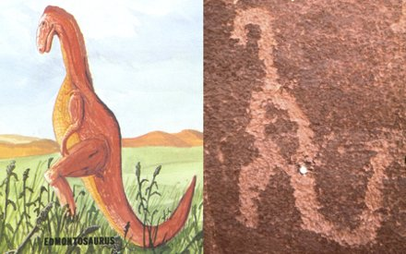
Doheny Expedition
https://www.apologeticspress.org/apPubPage.aspx?pub=1&issue=538
Left: Edmontosaurus (courtesy of Paul S. Taylor, Eden Communications).
Right: Petroglyph discovered by Dr. Samuel Hubbard in Havai Supai Canyon in Arizona (courtesy of www.bible.ca)
Notes:
“The fact that some prehistoric man made a pictograph of a dinosaur on the walls of this canyon upsets completely all of our theories regarding the antiquity of man.... The fact that the animal is upright and balanced on its tail would seem to indicate that the prehistoric artist must have seen it alive” (Hubbard, Samuel, 1925. Discoveries Relating to Prehistoric Man by the Doheny Scientific Expedition , pp. 5,7, emp. in orig.).
Bert Thompson and Brad Harrub effectually asked in their article, Walking Amidst The Dinosaurs, “Question: How could Indians have known how to draw such a perfect picture of an animal (the dinosaur) that they never had seen (or had described to them by someone who had seen it)?”
Now of course, evidence like this cannot exist or it cannot be genuine for the evolutionist because, dinosaurs have become extinct 65 million years ago! So they have to take the evidence and manipulate or discredit it to fit their prevailing paradigm!
Hence, opponents to the truth say, “There is no reason to interpret this image as a dinosaur. It has no dinosaur-specific features. Taylor's (1979, 1987) identification of the image as a hadrosaur such as Edmontosaurus is absurd, because the ‘tail’ is strongly upturned, whereas hadrosaurian tails were held horizontally, in line with the vertebrae of the torso; their tails were straight and were held stiffly in that configuration by a lattice of ossified tendons that prevented bending (Galton, 1970)” (http://palaeo-electronica.org/content/2012-issue-2-articles/275-rock-art-dinosaurs).
Excuse me, but how would they know the habits of such a creature? Have they observed the tendons? If they have, would that not also exclude millions of years? It is amazing how men are so quick to set aside irrefutable evidence! Had evolution not been so widely promoted or accepted, everyone would accept this as an ancient drawing of a dinosaur!

Slide 14
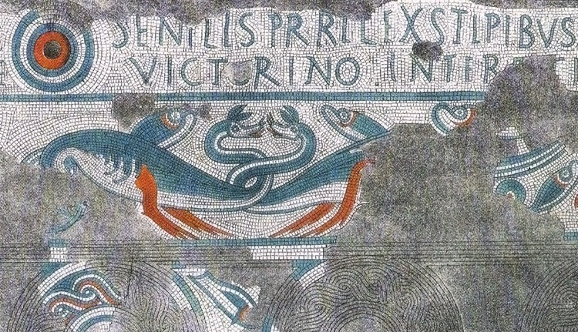
Ancient Roman mosaic showing two long-necked dragons by the sea (2nd century)
Courtesy of:
http://www.genesispark.com

Slide 15
Herodotus 484-425 BC
“There is a place in Arabia, situated very near the city of Buto, to which I went, on hearing of some winged serpents; and when I arrived there, I saw bones and spines of serpents, in such quantities as it would be impossible to describe. The form of the serpent is like that of the water-snake; but he has wings without feathers, and as like as possible to the wings of a bat”
[Historiae, 2, 75, 76].

Slide 16
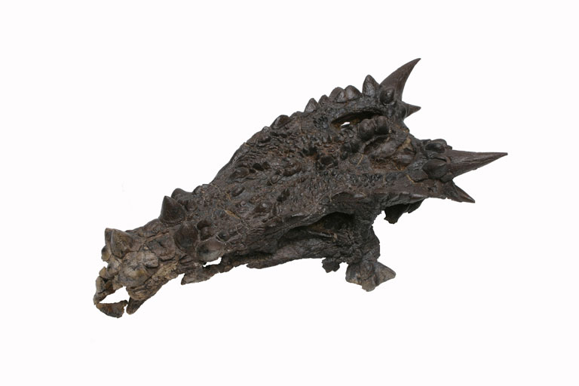
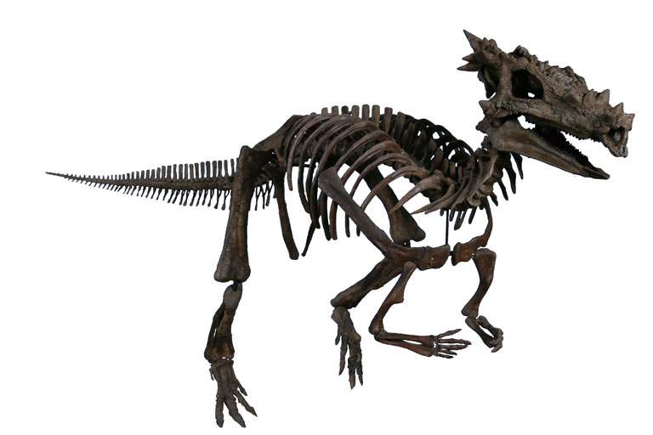
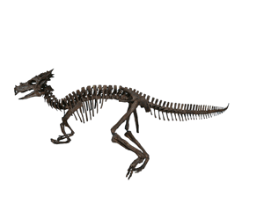
“Dracorex”
(dragon king)
Wikipedia Commons
http://creation.com/dracorexthe-dinosaur-that-looks-like-a-dragon
Discovered in South Dakota, 2003
Remains in Children’s Museum, Indianapolis
Notes:
This was a real creature. One can easily see how the modern view of dragons can be seen without much of the stretch of the imagination. Creationists have been making connections between dragons and dinosaurs for years. And then this fossil was discovered in South Dakota and was donated to the Children’s Museum of Indianapolis.

Slide 17
Some Biblical Designations
Tanniyn (Heb.), “dragon,” “monster,” “serpent”
  Not to be confused with “tanniym” (jackal)
  Tanniyn can reference several types of reptilian creatures in the Bible
    sea, land, flying

Slide 18
Hebrew “TANNIYN”
“So God created great sea creatures and every living thing that moves, with which the waters abounded, according to their kind. . .” (Gen. 1:21)
dragon, serpent, sea monster
  dragon or dinosaur
  sea or river monster
  serpent, venomous snake
  (Online Bible Hebrew Lexicon, Strong’s 8577)

Slide 19
Hebrew “TANNIYN”
(Exodus 7:9, 10, 12)
9 "When Pharaoh speaks to you, saying, ‘Show a miracle for yourselves,’ then you shall say to Aaron, ‘Take your rod and cast it before Pharaoh, and let it become a serpent.’"
10 So Moses and Aaron went in to Pharaoh, and they did so, just as the LORD commanded. And Aaron cast down his rod before Pharaoh and before his servants, and it became a serpent.
12 For every man threw down his rod, and they became serpents. But Aaron’s rod swallowed up their rods.
Notes:
Here the idea of Tanniyn is clearly that of a snake.

Slide 20
Hebrew “TANNIYN”
Nehemiah 2:13, “And I went out by night by the gate of the valley, even before the dragon well, and to the dung port, and viewed the walls of Jerusalem, which were broken down, and the gates thereof were consumed with fire” (KJV)
Psalm 74:13, 14, “You divided the sea by Your strength; you broke the heads of the sea serpents in the waters. You broke the heads of Leviathan in pieces, and gave him as food to the people inhabiting the wilderness” (NKJV; KJV, dragons; NASB, sea monsters)
Notes:
Nehemiah 2:13, The KJV translates it here as “dragon well.” The KJV translators were familiar with dragon creatures and saw that this term fit the word. The NKJV used “serpent well.” Obviously from 1611 to 1982 when the NKJV translators published the Old Testament the term dragon likely lost significance as a real creature.
Psalm 74:13, 14. This passage speaks of the devastation and oppression of God’s people most likely during the Babylonian invasion of Judea where the temple was demolished and all of the articles devoted to worship were carried off and desolated. This was a time when men blasphemed the God of heaven and trampled over the sheep of His pasture. Yet the Psalmist notes in a most poetical fashion of how God once delivered them from their enemies (74:12-15). Those things which would obstruct the passageway of God’s people were removed. However, even in this poetical passage, we learn that Leviathan is of the tanniyn.

Slide 21
Hebrew “TANNIYN”
Psalm 91:13, “Thou shalt tread upon the lion and adder: the young lion and the dragon shalt thou trample under feet” (KJV; serpent, NKJV)
Psalm 148:7, “Praise the LORD from the earth, ye dragons, and all deeps:” (KJV, great sea creatures, NKJV; )
Notes:
There is an interesting side note that I wish to make here. “Dragon” which was once a word that prevailed in the older translations has all but been dropped by newer versions. Why for the sudden disappearance? Because if dragons were dinosaurs it creates problems with the prevailing theory of evolution which displaces man from dinosaurs by over 60 million years.

Slide 22
Hebrew “TANNIYN”
Isaiah 27:1, “In that day the LORD with his sore and great and strong sword shall punish leviathan the piercing serpent, even leviathan that crooked serpent; and he shall slay the dragon that is in the sea” (KJV)
Jeremiah 51:34, “Nebuchadrezzar the king of Babylon hath devoured me, he hath crushed me, he hath made me an empty vessel, he hath swallowed me up like a dragon <08577>, he hath filled his belly with my delicates, he hath cast me out” (KJV, monster, NKJV)
Notes:
Isaiah 27:1, Again, Leviathan is spoken of as being of the tanniyn.
Notice from Jeremiah 51:4. Could dragon (tanniyn) here represent a dinosaur. It seems very likely that a large dinosaur is what Nebuchadrezzar (Nebuchadnezzar, NKJV) is being compared to. Something large enough to devour, crush and swallow man up.

Slide 23
Hebrew “TANNIYN”
Ezekiel 32:2, “Son of man, take up a lamentation for Pharaoh king of Egypt, and say to him: you are like a young lion among the nations, and you are like a monster in the seas, bursting forth in your rivers, troubling the waters with your feet, and fouling their rivers”
Notes:
This is another reference to something large enough which can burst forth, trouble (stirring) the waters with feet and fouling (treading) the rivers. As he had traits of a young lion, so he had traits of a monster who disrupted, disturbed, and distressed the river.

Slide 24
“Dragons”
Myth Or Real?
“The frequent references to dragons in the Bible, as well as in early records and traditions of most of the nations of antiquity, certainly cannot be shrugged off as mere fairy tales. Most probably they represent memories of dinosaurs handed down by tribal ancestors who encountered them before they became extinct”
(Henry Morris, The Genesis Record, p. 69)

Slide 25
Review of Lesson 1
There are many reasons why preachers ought to address dinosaurs
There is a strong connection between “dinosaurs” and “dragons”
  “Dinosaur” is a modern term which likely crossovers with many kinds of animals referred to in previous years as “dragons”
Many men have written about interactions with dragons
A dinosaur fossil discovered in 2003 looks dragon like and is even so named
The bible speaks on dragons as well as other kinds of magnificent creatures with the Hebrew word “tanniyn”
Leviathan was a tanniyn

Slide 26
Job 40:15-17
15 "Look now at the behemoth, which I made along with you; He eats grass like an ox.
16 See now, his strength is in his hips, And his power is in his stomach muscles.
17 He moves his tail like a cedar; The sinews of his thighs are tightly knit.

Slide 27
When God Says To “Behold”
We need to see what He wanted man to see
We need to ask why or what is the purpose of looking at it
In part 2 of this series we will look at the context that surrounds Behemoth and Leviathan!

Slide 28
Will You?
Behold the goodness and severity of God (Rom. 11:22)
Behold the virgin with child (Matt. 1:23)
Behold the Lamb of God who takes away the sin of the world (John 1:29)
Behold the Lion of the tribe of Judah (Rev. 5:5)
Behold the Lord comes with ten thousands of His saints to execute judgment on all (Jude 14, 15)
Behold the tabernacle of God is with men, and He will dwell with them (Rev. 21:3)

Slide 29
Get Into The Tabernacle of God Today By Obeying The Gospel!
“Repent, and let every one of you be baptized in the name of Jesus Christ for the remission of sins…Then those who gladly received his word were baptized; and that day about three thousand souls were added to them… And the Lord added to the church daily those who were being saved”
(Acts 2:38, 41, 47)

